Slide 1


VEMANA INSTITUTE OF TECHNOLOGY Koramangala, Bengaluru-34. Department of Computer Science and Engineering Project Phase-II Review 3
Batch No. 24 - NETWORK MONITOR
Under the Guidance of
Mr. NOOR BASHA,
Asst. Professor Department of CSE,
Vemana Institute of Technology
By
PAVITHRA K – 1VI17CS071
RAJASHREE – 1VI17CS114

Slide 2
BIRD VIEW
2020 - 21
Network Monitor
Introduction
Literature Survey
Comparative analysis of the survey
Problem Statement
System Specification
Design Methodology
Module Description
Implementation
Expected outcome
References
1

Slide 3
INTRODUCTION
2020 - 21
Network Monitor
Network Monitor is a scripted tool that alerts the User about various status changes and updates such as Reachability, Firmware version changes, Issues, Resource usage, Device Information and so on .
Alerts can be sent through various modes such as GUI, Email, SMS .
Various Protocols are used for obtaining these information such as ICMP, ARP, LLDP, SNMP and so on.
The various devices are supported by the system such as Servers, Routers, Switches, Virtual Machines, IoT Devices, Cloud Instances, Data Stores, Wireless Access Points, Endpoint PCs, Printers, Mobiles and so on.
2

Slide 4
LITERATURE SURVEY - 1
2020 - 21
Network monitor
[1] Network Monitoring System for Network Equipment Availability and Performance Reporting –by Baphumelele Masikisiki, Siyabulela Dyakalashre[2020]
It describes availability and performance of a network, reporting with UFH being used as a test platform. This system is meant to help network administrators with troubleshooting network devices because it will tell them exactly where to go in order to fix the network.
Advantage and Disadvantage
It used to test the availability and performances.
The limitation of reporting notifications with alarms were not successfully implemented .
3

Slide 5
Network monitor
2020 - 21
[2] Architecture of a Network Performance Monitor for Application Services on Multi-Clouds – by Young-min Kim, Ki-sung Lee, Jae-cheol Uhm, Si-chang Kim, and Chan-gun Lee [2018]
Rudimentary reasons for having a network performance monitor for multi-cloud environments have been illustrated with examples in this research. An architecture for such a network monitor is proposed that explains how external agents are used to connect monitor such an environment.
Advantages and Disadvantages:
The model proposed for monitoring multi clouds is flexible and is integrated using external agents.
A DBMS approach to store results for offline analysis has been proposed which would be good for non-cloud network monitoring systems as well.
4

Slide 6
2020 - 21
Network monitor
[3] Measurement-Aware Monitor Placement and Routing: A Joint Optimization Approach for Network-Wide Measurements – by Guanyao Huang, Chia-Wei Chang, Chen-Nee Chuah, and Bill Lin [2017]
A theoretical framework is proposed in this research that jointly optimizes monitor placement and dynamic routing strategy to achieve maximum measurement utility with limited monitoring resources.
Advantages and Disadvantages:
There are many implementation issues with the proposed framework that need to be addressed especially determining what routing protocols are being used.
The major take away from this research is the procedure involved in forming the base framework for a network monitoring system.
5

Slide 7
2020 - 21
Network monitor
[4] A Web-based monitor and management system architecture for enterprise virtual private network – by Ruey-Shun Chen , Change-Jen Hsu, Chan-Chine Chang [2019]
Monitoring encrypted connection gateways such as enterprise VPNs is a tedious task. This papers formulates a feasible system that can monitor VPNs and includes essential elements such as system components, operation flow and much more.
Advantages and Disadvantages:
This research is primarily localized on VPNs and encrypted gateways such as SSLVPN, Client-based VPNs and so on.
It is still dependent on external management tools in order for the enterprises to be rest assured for using the new technologies.
6

Slide 8
COMPARATIVE ANALYSIS
2020 - 21
Network Monitor
Reference | Technique | Advantage | Drawback
Network Monitoring System for Network Equipment Availability and Performance Reporting | SNMP | Used to Test the Performance and Availability | Memory configuration
Architecture of a Network Performance Monitor for Application Services on Multi-Clouds | Multi-Cloud | Flexible and first of its kind | Network intensive and simulated results
Measurement-Aware Monitor Placement and Routing: A Joint Optimization Approach for Network-Wide Measurements | Routing | Method to implement a framework | No Real-time analysis
A Web-based monitor and management system architecture for enterprise virtual private network | VPN | Integration of GUI with back end | Covers only VPNs
7

Slide 9
PROBLEM STATEMENT
Network Monitor
2020 - 21
There are many open source and commercial products which provide network monitoring facilities.
These applications provide network engineers and administrators with many features and tools to identify and examine network infrastructure.
Many of the monitoring tools available in the industry provide specific monitoring tasks which are limited for one feature.
It Implements web interface for the users to view and monitor network and server and also the terminal for viewing configurations of network devices.
8

Slide 10
SYSTEM SPECIFICATION
2020 - 21
Network Monitor
Hardware Specifications:
Processor: Intel® Core i5 ™ CPU and above
RAM: 8 GB or higher
Hard Disk: 100 GB or higher
Software Specifications:
Operating System: Windows 10/Ubuntu 20.04 LTS
Architecture: 64-bit OS
Python 3.8 or higher
PIP Packages: RegEx, Django, Pymysql
Database: MySQL5.7 or higher
JavaScript 1.8.5 or higher
Front End: HTML5, CSS3, Bootstrap4
9

Slide 11
DESIGN METHODOLOGY
2020 - 21
Network Monitor
Methodology describes various protocols used to complete the project:
ICMP: Ping is a basic Internet program that uses ICMP and allows a user to verify that a particular IP address exists and can accept requests. Ping is used diagnostically to ensure that a host computer the user is trying to reach is actually operating. Ping works by sending an Internet Control Message Protocol (ICMP) Echo Request to a specified interface on the network and waiting for a reply. Ping can be used for troubleshooting to test connectivity and determine response time Ping command is very useful in debugging and testing network and internet connection
SNMP: The Simple Network Management Protocol (SNMP) is a standard internet protocol, for maintaining devices and proactively let you know what’s going on your network. SNMP Managed Network Components are:
Managed Device : this is a network node that contains an SNMP agent on a managed network. Management devices include Router, Switch it store the information collected and make it available on Network-Management Systems (NMS).
Agent: This is a software that is installed on a device that is being managed by SNMP.
Network Management System: This is software is installed on Manger
10

Slide 12
Network Monitor
2020 - 21
ARP: The Address Resolution Protocol (ARP) is a communication protocol used for discovering the link layer address, such as a MAC address, associated with a given internet layer address, typically an IPv4 address. The Address Resolution Protocol uses a simple message format containing one address resolution request or response. The message header specifies the types of network in use at each layer as well as the size of addresses of each.
LLDP: The Link Layer Discovery Protocol (LLDP) is a vendor-neutral link layer protocol used by network devices for advertising their identity, capabilities, and neighbors on a local area network based on IEEE 802 technology, principally wired Ethernet. Media Endpoint Discovery is an enhancement of LLDP, known as LLDP-MED, that provides:
Auto-discovery of LAN devices
Device location discovery to allow creation of location databases and, in the case of Voice over Internet Protocol (VoIP)
Inventory management, allowing network administrators to track their network devices, and determine their characteristics (manufacturer, software and hardware versions, serial or asset number).
12/05/2021
11

Slide 13
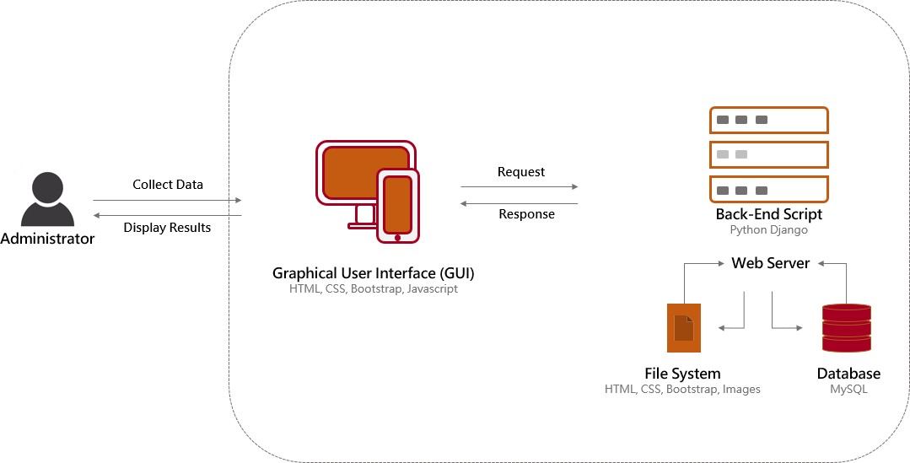
MODULE DESCRIPTION
2020 - 21
Network Monitor
System Architecture
12

Slide 14
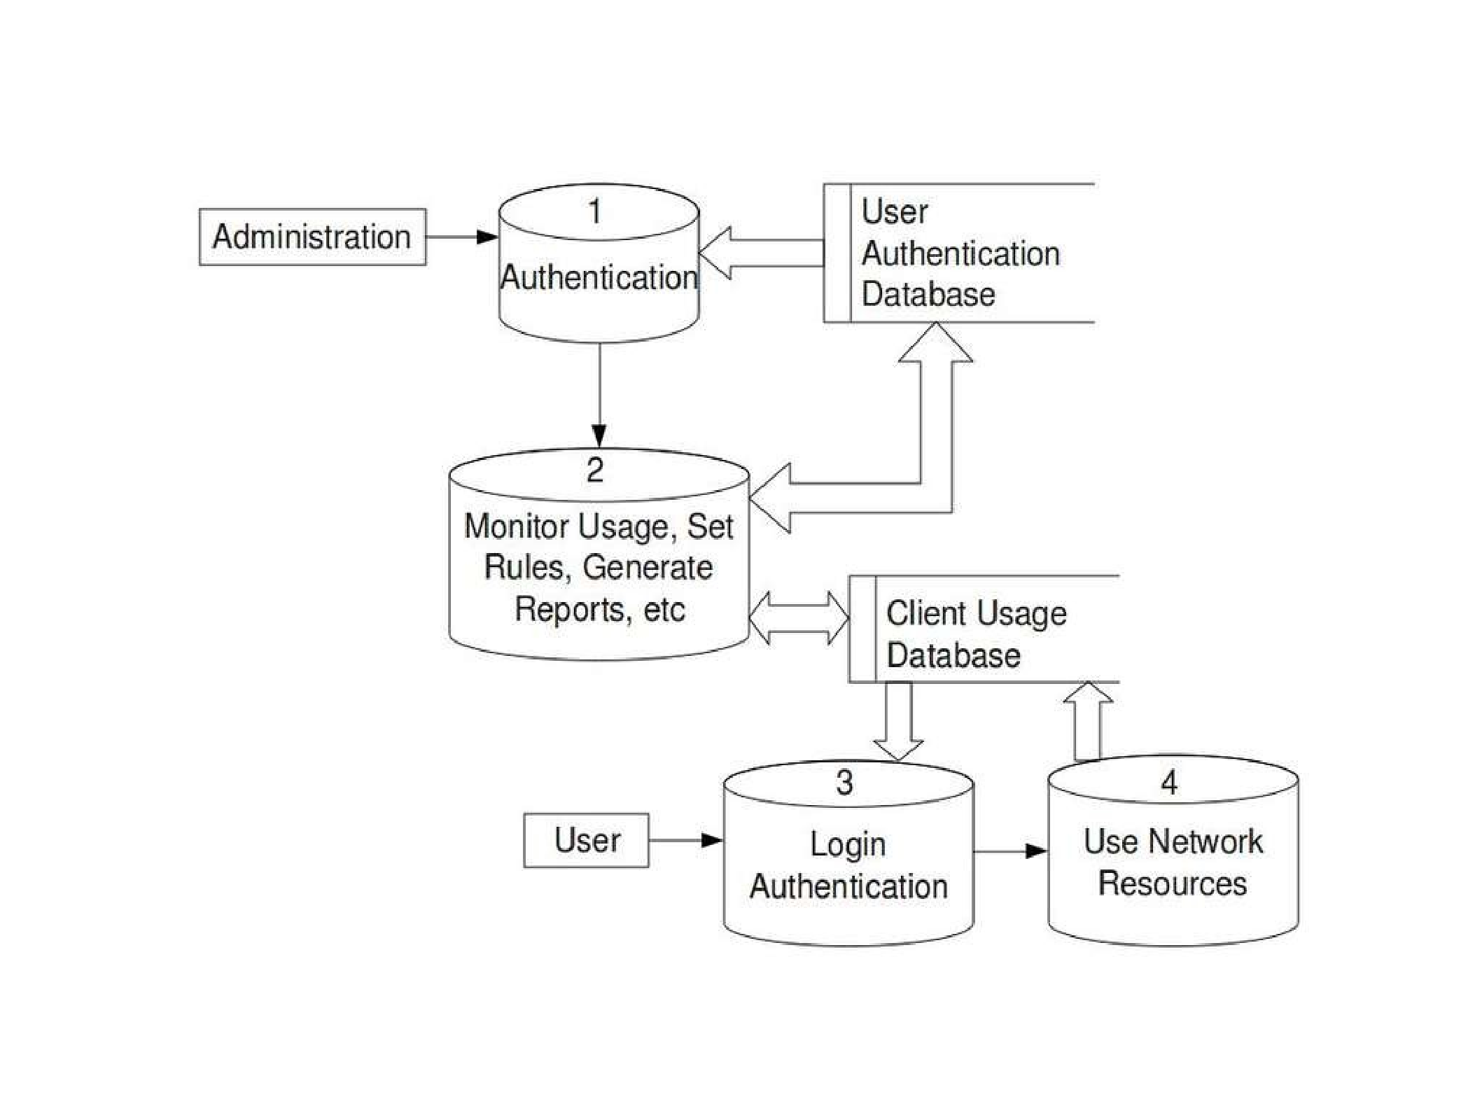
2020 - 21
Network Monitor
Data Flow Diagram
13

Slide 15
Network Monitor
2020 - 21
IMPLEMENTATION
Graphical User Interface:
This facilitates the user to login into the system, initiate the utility, whereby detail of the entire network is present in a table.
The Traffic Status will show up eventually which are obtained from the device using ICMP protocol
The user can also see all the performance attributes such as reachability, latency and so on present on any network node by switching between tabs.
Coding Languages used for this Component: HTML, CSS, Bootstrap Templates, JavaScript
Back-end Processing:
This module handles all functionality from finding the network nodes, attributes, querying with the network nodes and updating the database with information obtained through back end processing.
14

Slide 16
Network Monitor
2020 - 21
Coding Languages used for this Component: Python, Django Framework, JavaScript, pymysql framework.
Database:
This module handles acts a buffer between the backend functionality and the graphical user interface. It provides synchronization between the activities of the user and the backend
MySQL Tables used:
UserAuthentication: Deals with user login, logout, and session keys
Devices: Deals with devices and their attributes at real time
Languages used for this Component: MySQL Database, MySQL query Language, MySQL Workbench
15

Slide 17
EXPECTED OUTCOME
2020 - 21
Network Monitor
A fully functional network monitoring system that can overlay various monitoring protocols such as ICMP, SNMP, SYSLOG, ARP, LLDP and so on to obtain all information about various network nodes.
Development of easy installation script setup documentation.
A lucid, user-friendly User Interface for the application that can display information with right intensity
Consistent triggering for alerts in any inconsistent conditions that found in a network
Alerts should be sent to the users configured as per their customizations.
16

Slide 18
REFERENCES
2020 - 21
Network Monitor
[1] Network Monitoring System for Network Equipment Availability and Performance Reporting –by Baphumelele Masikisiki, Siyabulela Dyakalashre[2020]
[2] Architecture of a Network Performance Monitor for Application Services on Multi-Clouds – by Young-min Kim, Ki-sung Lee, Jae-cheol Uhm, Si-chang Kim, and Chan-gun Lee 2018
[3] Measurement-Aware Monitor Placement and Routing: A Joint Optimization Approach for Network-Wide Measurements – by Guanyao Huang, Chia-Wei Chang, Chen-Nee Chuah, and Bill Lin 2017
[4] A Web-based monitor and management system architecture for enterprise virtual private network – by Ruey-Shun Chen , Change-Jen Hsu 2019
17

Slide 19
THANK YOU
2020 - 21
Network Monitor
18

